Slide 1



Project Report
​
Student Name: Satyam Suresh
​
Internship Program: Naviotech Solution
​
Guide / Mentor: Sir Mahesh
A Comprehensive Academic Study
Academic Year 2026

Slide 2
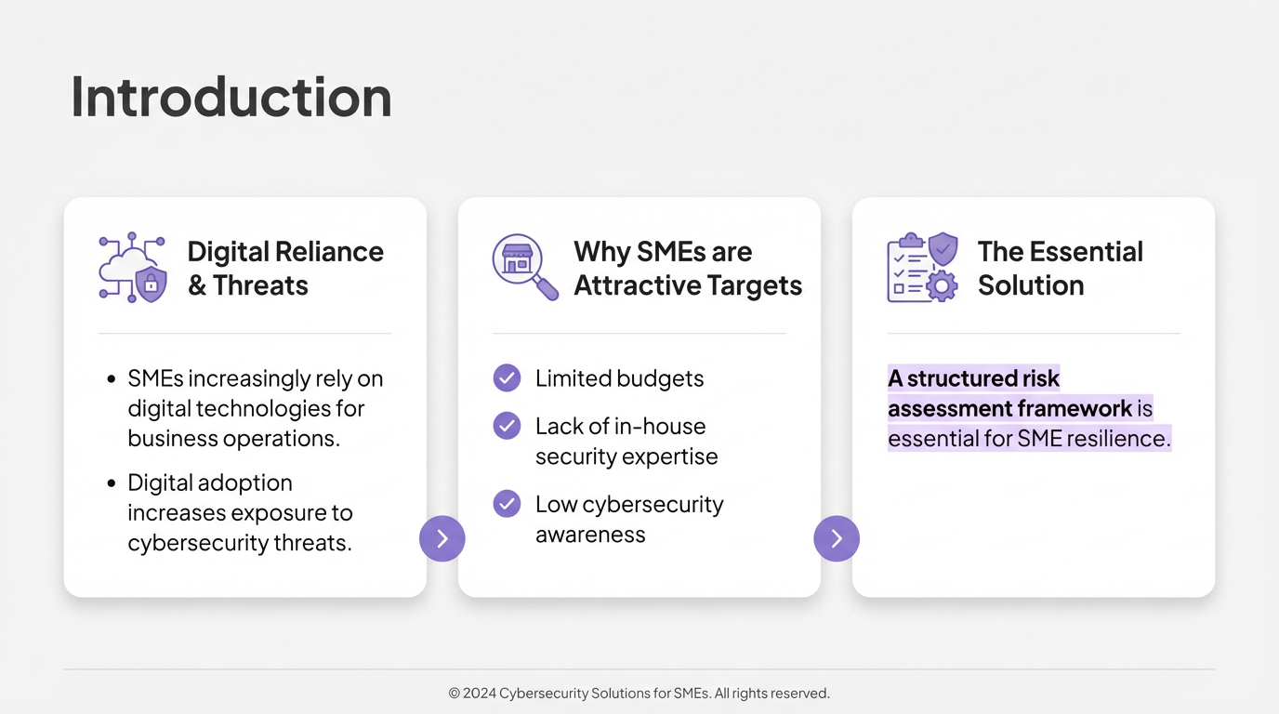

Slide 3
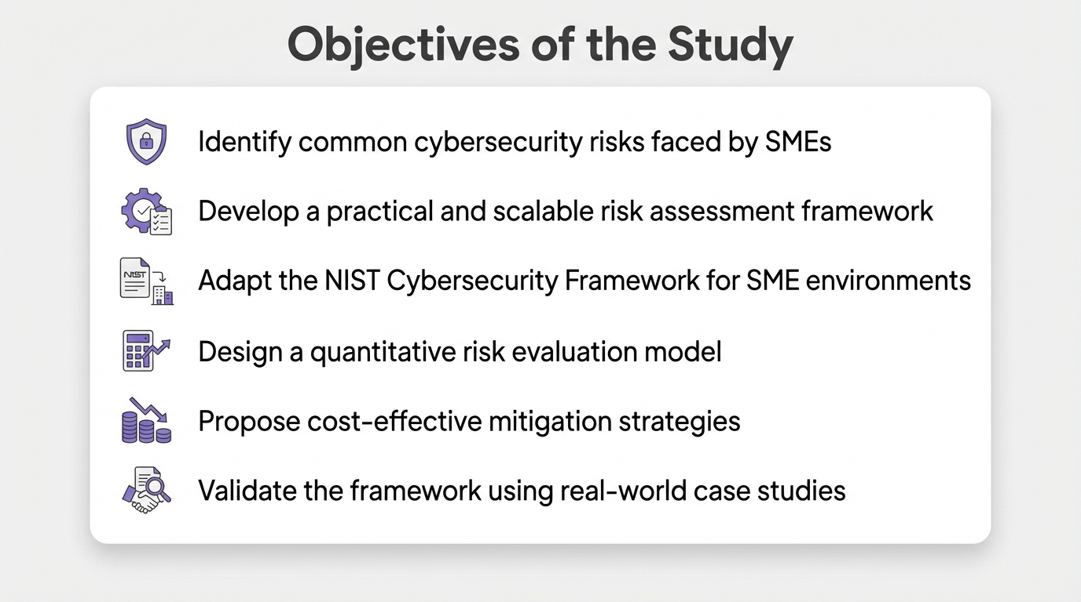

Slide 4
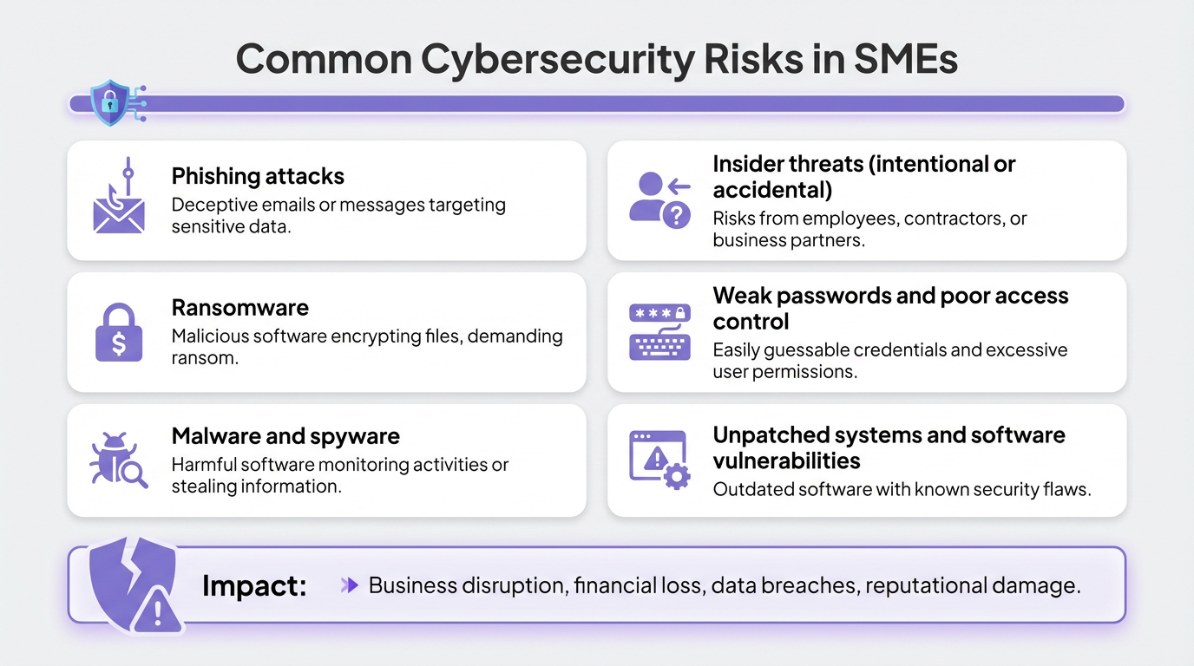

Slide 5
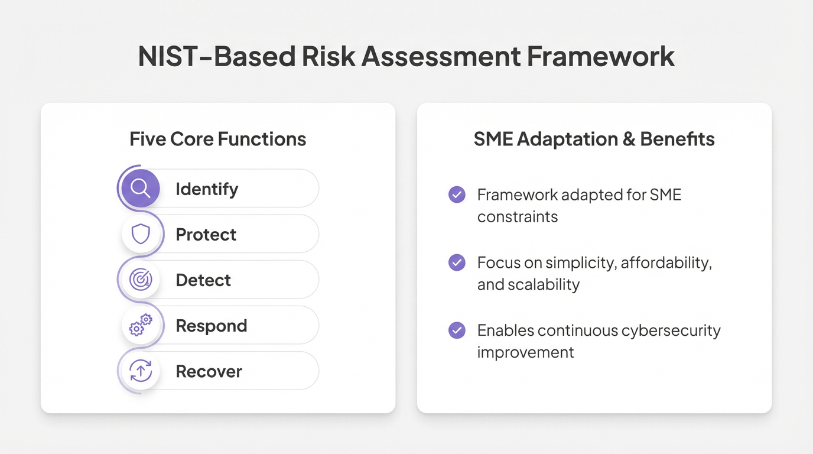

Slide 6
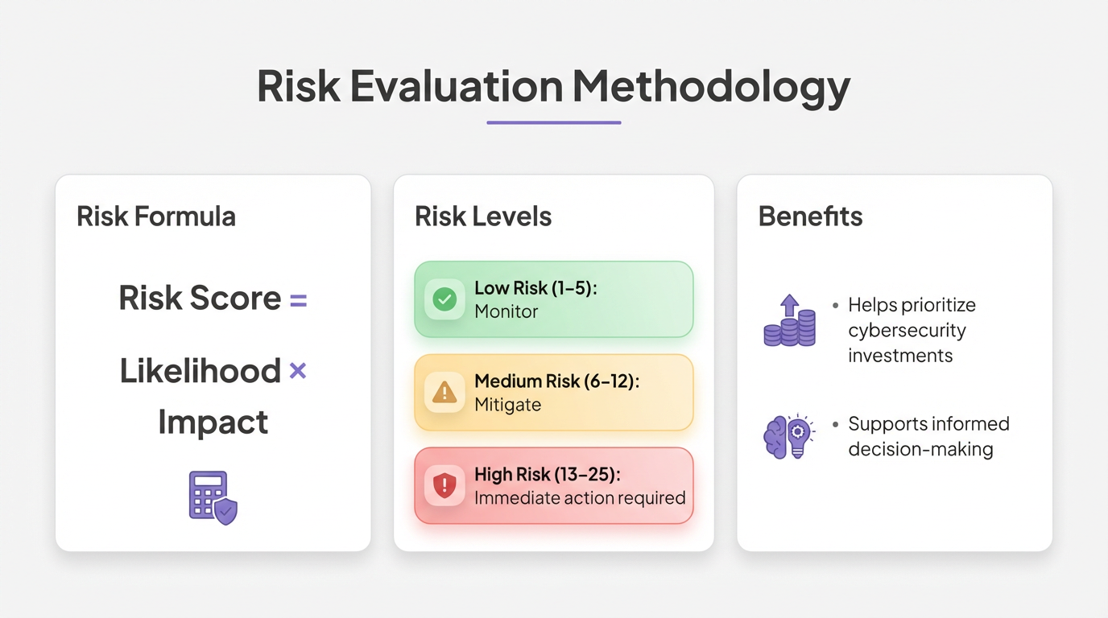

Slide 7
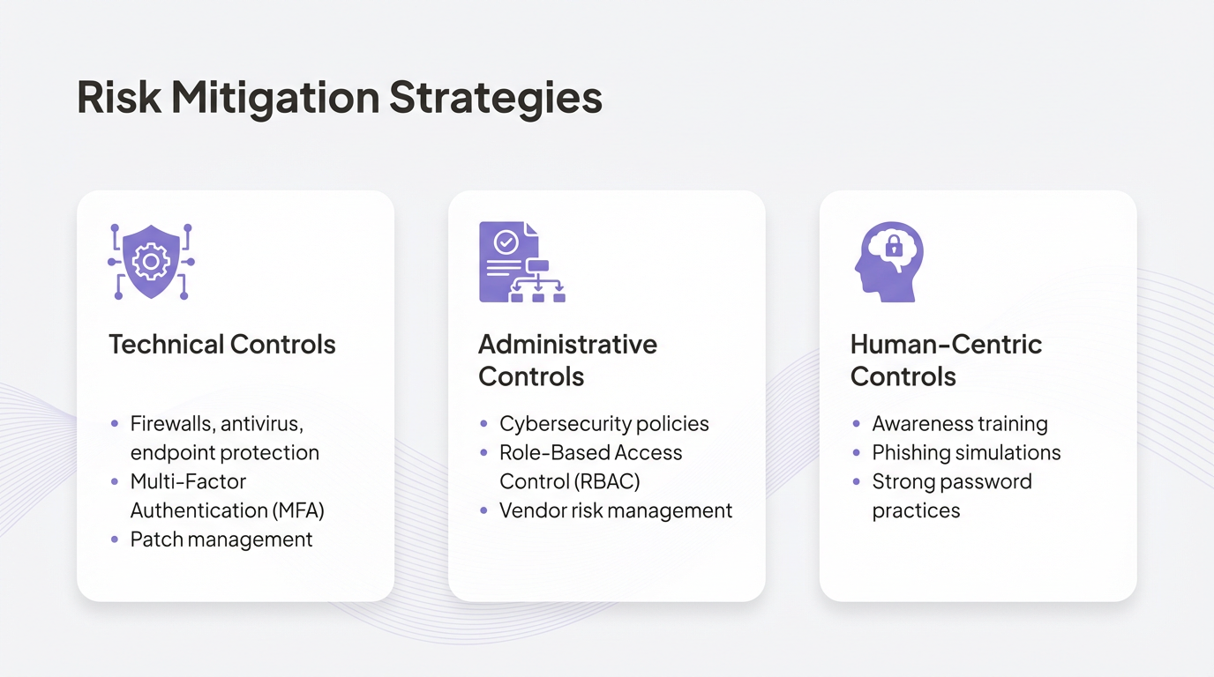

Slide 8
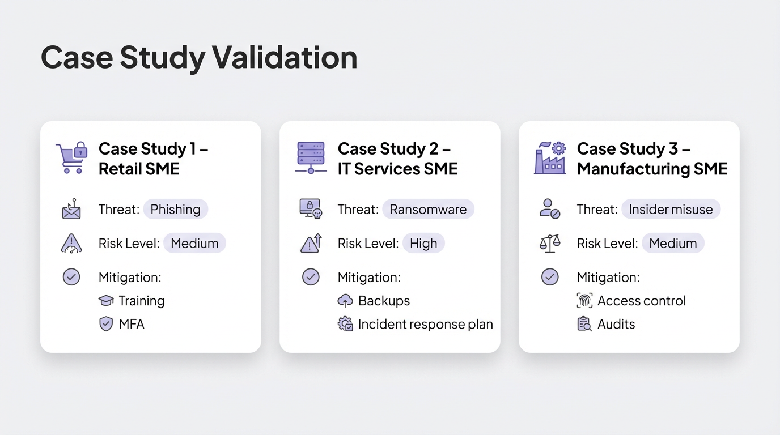

Slide 9
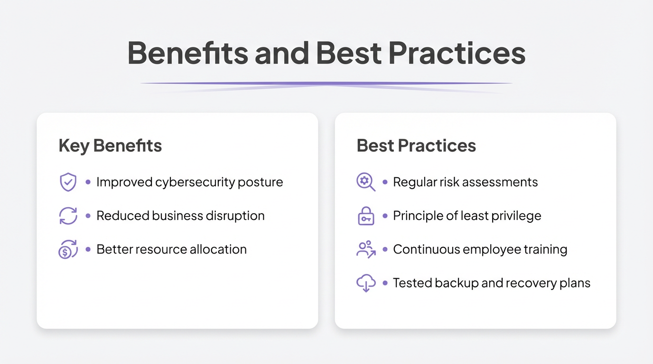

Slide 10
